Slide 1

Today’s Contents
Basics Relationships between Pixels
Neighborhood
Adjacency
Connectivity
Regions and boundaries
Distance
Chapter 2 from R.C. Gonzalez and R.E. Woods, Digital Image Processing (3rd Edition), Prentice Hall, 2008 [ Section 2.5 ] [Problems: 2.9 ~ 2.17
excluding 2.14]

Slide 2
Pixel and their Relationships

Slide 3
Conventional indexing method of Pixels
(0,0) x
 | (x-1,y-1) | (x,y-1) | (x+1,y-1)
 | (x-1,y) | (x , y) | (x+1,y)
 | (x-1,y+1) | (x,y+1) | (x+1,y+1)
y
Conventional indexing method
4

Slide 4
Pixel and their Relationships
Neighbors of a pixel
Neighborhood relation is used to tell adjacent pixels.
It is useful for analyzing regions.
3 types of neighbors
N₄(p): 4-neighbor of p
N_{D}(p): diagonal neighbor of p
N₈(p): 8-neighbor of p
4

Slide 5
N₄(p): 4-neighbor of p
considers only vertical and horizontal neighbors pixels.
Note: q ∈ N₄(p) implies p ∈ N₄(q)
4-neighbors of p:
 |  | (x,y-1)
 | (x-1,y) | p | (x+1,y)
 |  | (x,y+1)
(x−1,y)
(x+1,y)
(x,y−1)
(x,y+1)
N₄(p) =
Each of them is at a unit distance from P.
5

Slide 6

N_{D}(p): diagonal neighbor of p
considers only diagonal neighbors pixels.
Note: q ∈ N_{D}(p) implies p ∈ N_{D}(q)
Diagonal neighbors of p:
 | (x-1,y-1) |  | (x+1,y-1)
 |  | p
 | (x-1,y+1) |  | (x+1,y+1)
(x−1,y−1)
(x+1,y−1)
(x−1,y+1)
(x+1,y+1)
N_{D}(p) =
Each of them are at Euclidean distance of 1.414 from P.
6

Slide 7
N₈(p): 8-neighbor of p
considers all neighbors pixels.
Note: q ∈ N₈(p) implies p ∈ N₈(q)
8-neighbors of p:
 | (x-1,y-1) | (x,y-1) | (x+1,y-1)
 | (x-1,y) | p | (x+1,y)
 | (x-1,y+1) | (x,y+1) | (x+1,y+1)
(x−1,y−1)
(x,y−1)
(x+1,y−1)
(x−1,y)
(x+1,y)
(x−1,y+1)
(x,y+1)
(x+1,y+1)
N (p) =
8
7

Slide 8
Some of the points in the N4, ND and N8 may fall outside image when P lies on the border of image.

Slide 9
Pixel Adjacencies
Adjacencies depends on both
neighborhood
Pixel gray values
Two pixels are connected if they are neighbors and their gray levels satisfy some specified criterion of similarity.
For example, in a binary image two pixels are connected if they are 4-neighbors and have same value (0/1).

Slide 10
Pixel Adjacencies
Adjacencies depends on both
neighborhood
Pixel gray values
Let V be the set of intensity values
Adjacent pixels must be neighbors and have gray values from the same set, V
In binary image, V = {1} if we are referring to adjacency of pixels with value 1
In gray-scale image, V can be any subset of 256 values

Slide 11
Pixel Adjacencies
3 types of adjacencies
4-adjacency
8-adjacency
m-adjacency

Slide 12
Pixel Adjacencies
4-adjacency
Two pixels p, q are 4-adjacent if
q is in the set N₄(p)
p, q have values from set V,
(V be the set of intensity values )
N₄(p)
 | p | q
 | r

Slide 13
Pixel Adjacencies
8-adjacency
Two pixels p, q are 8-adjacent if
q is in the set N₈(p)
p, q have values from set V,
(V be the set of intensity values)
N₈(p)
q |  | r
 | p

Slide 14

Pixel Adjacencies
m-adjacency
Two pixels p, q are m-adjacent if
p, q have values from set V, and
q in N₄(p), or
q in N_{D}(p) and
has no pixel with value from V
q
p
t
s
p, q are not m-adjacency pixels
s, t are m-adjacency pixels

Slide 15
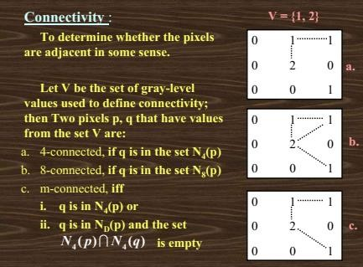

Slide 16
Distance Metrics
Let pixels p, q and z have coordinates (x,y), (s,t) and (u,v) respectively.
D, distance function has following properties:
D(p,q) ≥ 0 [D(p,q) = 0 iff p = q and]
D(p,q) = D(q,p) and
D(p,z) ≤ D(p,q) + D(q,z)

Slide 17
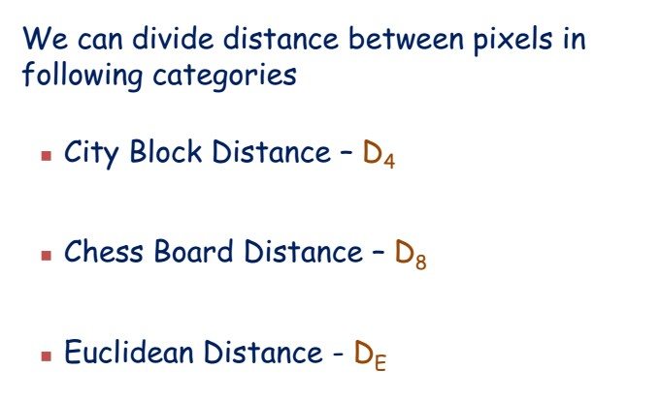
Distance Metrics

Slide 18
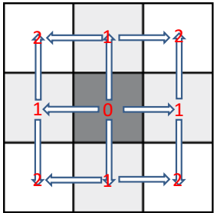
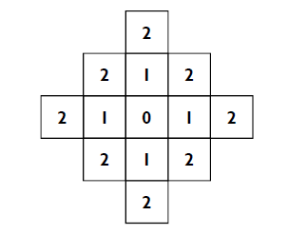
City block distance (D4 distance)
D₄ ( p, q) = x − s + y − t
Diamond with center at (x,y)
D₄ = 1 are the 4 neighbors of pixel p(x,y)

Slide 19
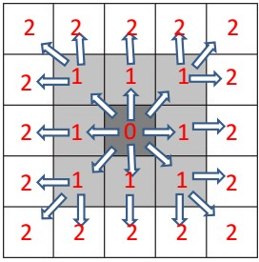

Chessboard distance (D8 distance)
D₈ ( p, q) = max( x − s , y − t )
Square centered at p(x,y)
D₈ = 1 are the 8 neighbors of pixel p(x,y)

Slide 20
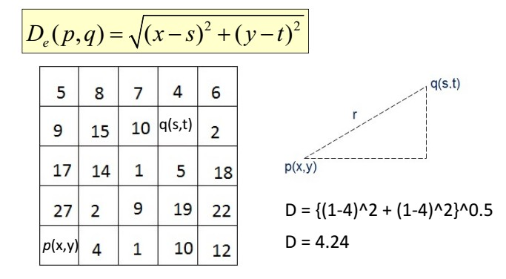
Euclidean Distance
A circle with radius r centered at (x,y)

Slide 21

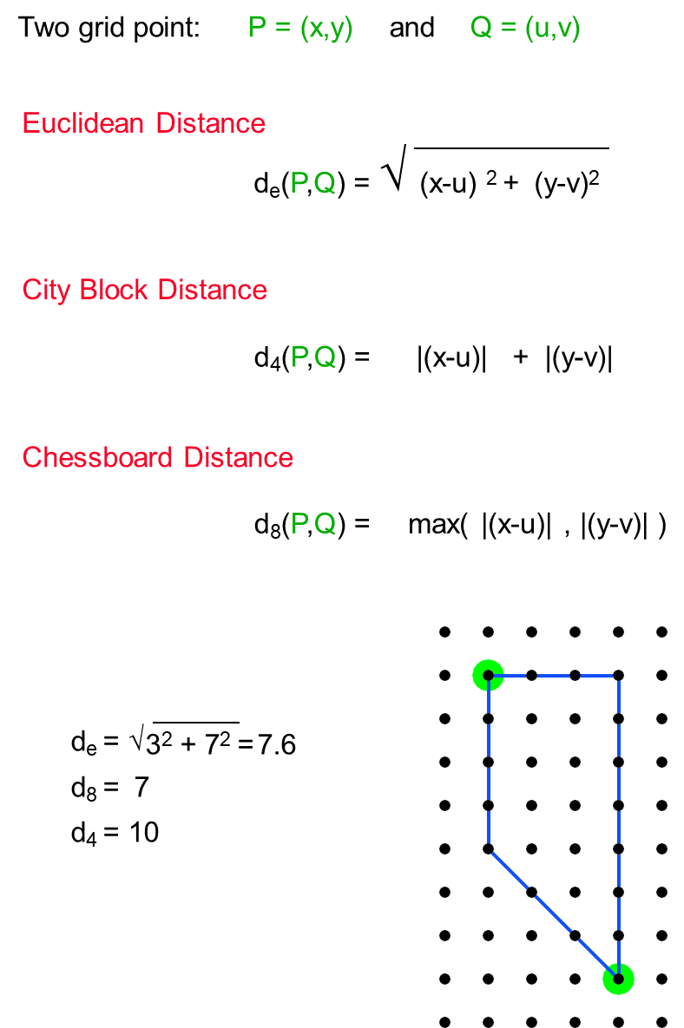

Slide 22
Math: Suppose p and q are two pixels
Calculate the Distance measures D4, D8 and De
Here, the Set v is given v={2,4}
y
0 1 2 3
p
(x,y)
4 | 2 | 2 | 3
4 | 3 | 2 | 1
1 | 2 | 2 | 0
1 | 3 | 1 | 0
0
1
2
3
q
x
(s,t)

Slide 23
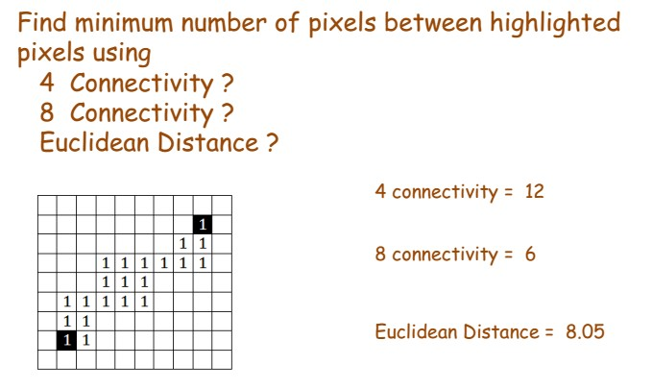
Distance Measures
(7^2+6^2)^0.5
= 9.22
29

Slide 24

Class/Home Work
3 | 1 | 2 | 1(a)
2 | 2 | 0 | 2
1 | 2 (p) | 1 | 1
1(b) | 0 | 1 | 2
N₄(p) =?
N₈(p) =?
N_{m}(p) =? If V={1,2}
Is (a) 4-adjacent of (b)?
Is (a) 8-adjacent of (b)?
Is (a) m-adjacent of (b)?
Calculate D₄ = ?, D₈ = ?, D_{e} = ? for the point (a) ^ (b).
Text Book 1
Chapter 2: Problems: 2.9 ~ 2.17 excluding 2.14

